Slide 1
Probability
Introduction

Slide 2
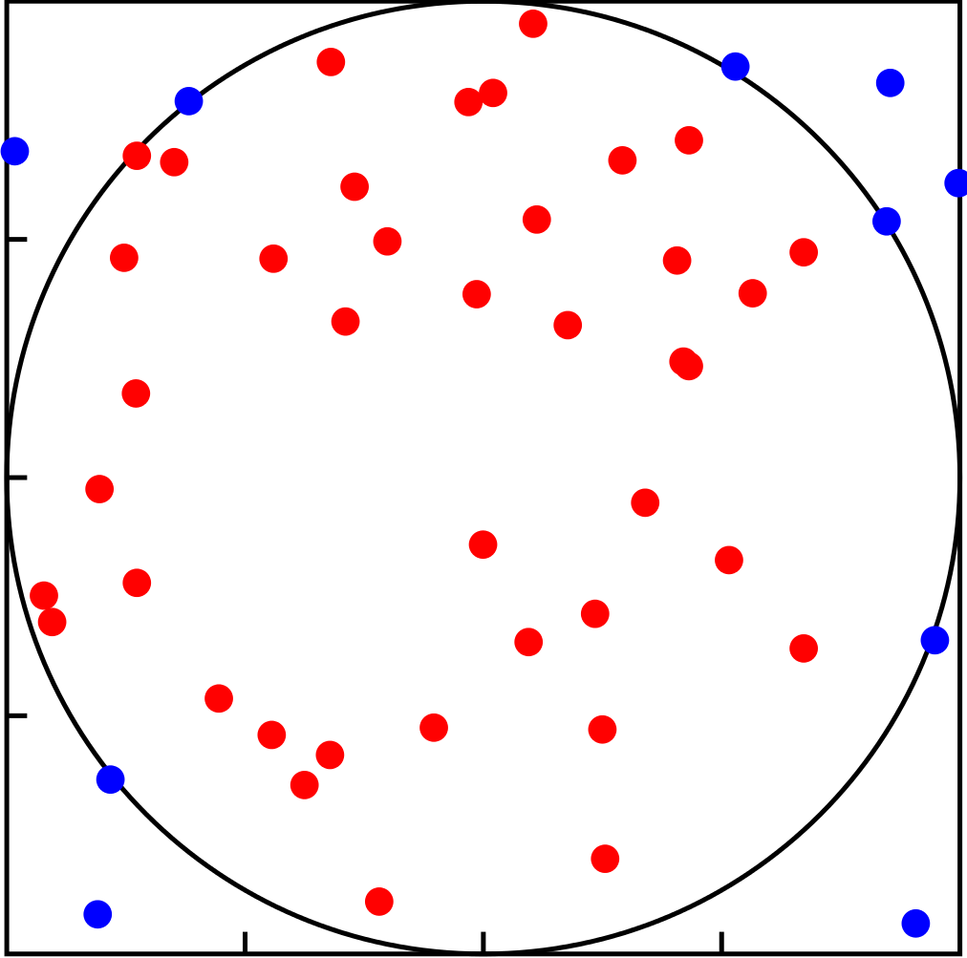
What is probability?
Different philosophical interpretations
On one hand:
We can imagine an area, which is the universe or support
And a "sub-area"
The probability of throwing a dart and hitting the sub-area is related to the size of that area
"If we throw 100 darts at random, X% will land in the circle"

Slide 3
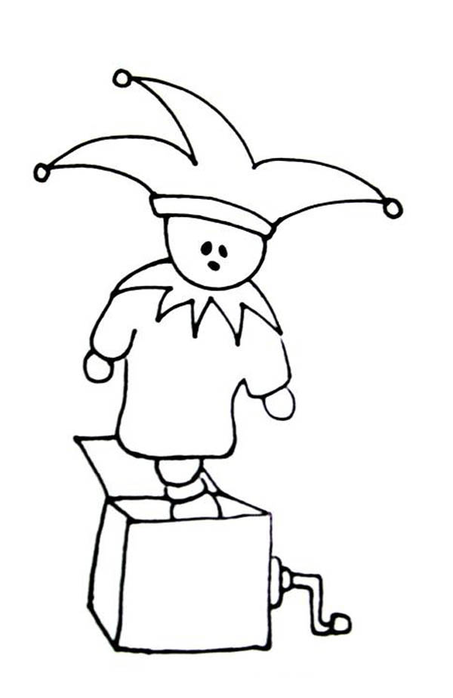
What is probability?
Now instead of frequencies, let's think about mechanisms
Imagine a machine that produces events
This machine uses a certain criterion to decide what to generate (f)
f

Slide 4
Putting both together
The coin is one of these machines
If the coin is fair, it generates using the "distribution" of the universe as on the right
Heads
Tails

Slide 5
Random variables
The formalization of this is called random variables.
We intuitively define two concepts:
Support — the possible universe of what we can generate (events)
Probability distribution (or probability function) — the criterion by which things are generated (according to the weight/area of events)
By convention, the probability of the entire universe is 1. That is why it is often shown as a percentage.

Slide 6
A bit of notation
If the probability of an event e under a probability function f is p, which is part of the set of all possible events E. Then we can write.
f(e) = p
It is common to omit that f is the function, and to simply write it as the probability of the event
P(e) = p

Slide 7
Back to the coin
In the case of the coin, since there are only two possible events, it is enough to define the probability of one of the two
P(Heads) = 1 − P(Tails) = p
So the probability function is completely defined by p
This is called a "parameter"
Heads
Tails

Slide 8
Back to the coin
For the coin to be fair, the probabilities of the two events must be equal.
p = 1−p = 1/2
But it doesn't have to be that way. We could have different values of p
Heads
Tails

Slide 9
Conditional probability

Slide 10
Varying p
What if p is also generated by a random variable?
P(Coin)
P(p)
p
Heads/Tails

Slide 11
Another way to see it
Heads
p

Slide 12
More notation
We can denote a dependence between variables as follows:
P(Coin | p)

Slide 13
Law of total probability
If we have a partition of the universe A1, A2, …, An (non-intersecting sets whose union is the universe), then we can obtain the probability of another event from the conditionals.
P(B) = P(B|A1)P(A1) + P(B|A2)P(A2) + … + P(B|An)P(An)

Slide 14
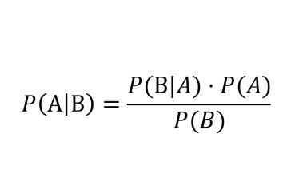
Bayes' theorem
"Inverse" problems

